Slide 1
Web 3.0: Blockchain and Decentralised Apps Brendan Dillon Rounded Resources bdillon@roundedresources.com

Slide 2
Agenda
What is blockchain?
Why is it important?
What problems does it solve?
How It Works
A very brief look at the key ideas
Security, Privacy and Trust
Some Examples in IoT
Q&A

Slide 3
Background
Blockchain is a fundamental and transformational technology
Similar to how HTTP transformed the internet into the World Wide Web
It is also a fundamental breakthrough in trust
It uses financial incentives to reward behaviours that sustain it’s trust ecosystem
It will significantly impact how the internet works
Sometimes called Web 3.0
It will radically alter business models
It will enable new variants of existing business models, as well as completely new business models

Slide 4
The Eight Blockchain Value Clusters
Automating Agreements
Legal contracts as code (aka Internet of Agreements, Smart Contracts): IP licensing, escrow, warranties, service agreements etc.
Mechanisms to combine legal contracts and smart contracts
Predictability, reliability, low cost, transparent, auditable
Securing Property Rights
Securing ownership rights: real-time proof of ownership, dispute resolution
Streamlining transfers: real estate, intellectual property, virtual goods, financial instruments etc.
Reduce costs, secure, reliability, transparency, auditable
Lowering Transaction Costs
Technologies that reduces the need for intermediaries
Reduce information asymmetries, search costs and/or risk of fraud and theft
Proving Authenticity
End to end traceability, radical transparency
Supply chain traceability: fair trade, quality / safety of raw materials (meat products, toxic materials), ethical sourcing
Transferring Value / Incentives
Payments, micropayments, royalties, e-commerce, exchanges, prediction markets, gambling, settlement
Loyalty, rewards
Streamlining Group Coordination
Sharing economy, crowdfunding, co-ops
Voting, self-organizing communities
Secure Machine Coordination
M2M, AI bots, IoT, energy grids
Identity, reputation, accessing scarce resources
Secure Data Sharing
Auditing, compliance, fraud detection
Enterprise data sharing platforms, consumer privacy / self-sovereign data

Slide 5
Interesting Projects
Currencies: Bitcoin, Litecoin
Privacy-Protecting Currencies: zCash, Monero, Dash
Banks / Payment Networks: Ripple, Stellar, Humaniq, Polybius, TenX, Tether
Solution Platforms / Smart Contracts: Ethereum, Tezos, Toshi, Eos, NEM, Nxt, Hyperledger
Storage: Sia, Filecoin, Storj
Distributed Cloud / Supercomputing: Golem, iExec, Dfinity, Sonm
Prediction Markets: Augur, Gnosis
Other notable examples:
Steem (Social Networks)
Bancor (Currency Trading)
Waves (Crowdfunding)
PrimalBase (Co-working)
Basic Attention Token (Browser)
Block.one (Business Platform)

Slide 6
Blockchain Characteristics
Decentralized
Peer-to-peer network
Consensus
Incentives / Tokens
Governance
Permissioned vs Permissionless

Slide 7
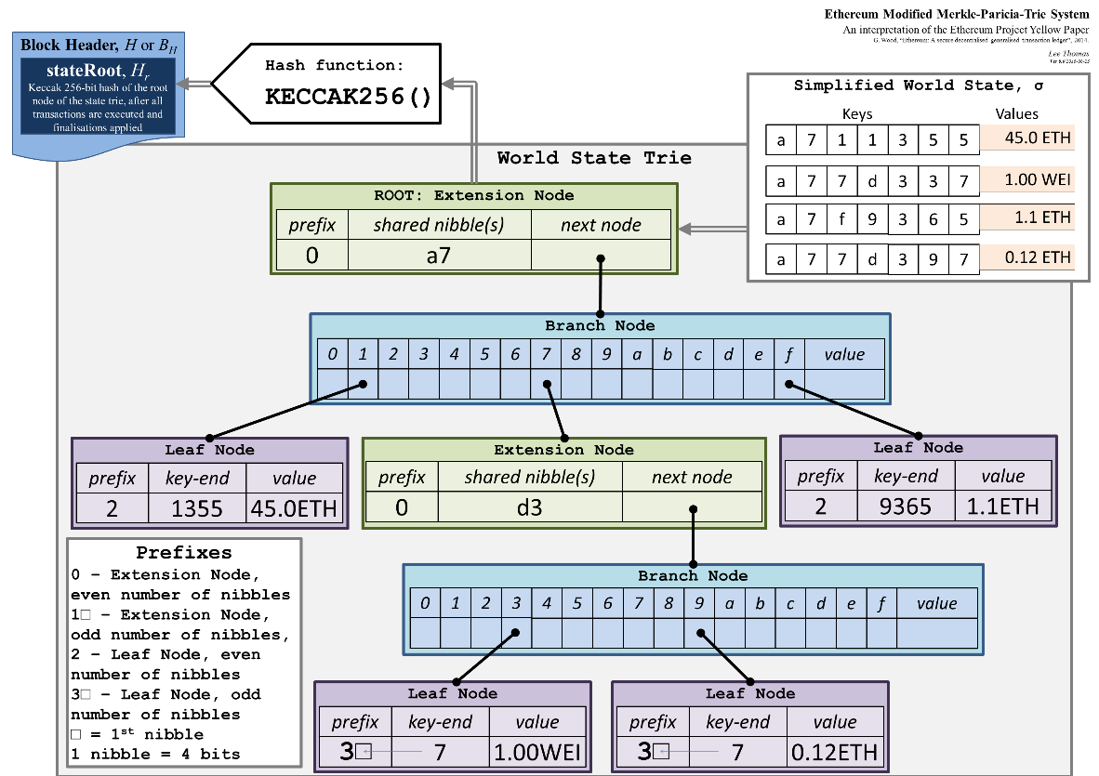
The Ethereum Toolchain
P2P Network Nodes
Written in C++, Go, Java, Rust and Python
Smart contracts programming languages:
JavaScript-like: Solidity
Python-like: Serpent, Viper
Lisp-like: LLL
C-like: Mutan
Tools
Mist browser
Web3.js – Javascript API
Ethereum Wallet
IDE: Mix / Remix, Dapple, Truffle
Frameworks: Embark, Populus
Base Services
Whisper messaging
Swarm – data storage and distribution
Name registry
Contract registry
Casper consensus module (Research project)
Dapps – decentralised apps

Slide 8
Security, Privacy and Trust

Slide 9
Security: A Brief Overview
Consensus Attacks
Fault tolerance and Byzantine Generals
Proof of Work: hashcash + mining rewards + transaction fees to incentivize good behaviour
51% attack: double spending their own tokens used in the last 6 or 7 blocks
Proof of Stake: Mauve Whitepaper
The DAO Hack
Poorly implemented smart contract
$150M raised, $60M stolen, most of that recovered by forking the blockchain
Formal Verification
Proving that a smart contract has expected properties in all scenarios

Slide 10
Privacy: Self-Sovereign Data
Self-Sovereign Data
Secure Multiparty Computation
Zero Knowledge Proofs
Verified Algorithms
The Key Principles
You own your own data
You can choose to share it with others
Move the algorithms to the data e.g. make it available to verified algorithms
Open up social sharing for community benefit e.g. training AIs for social good

Slide 11
Trust: Decentralising Airbnb / Uber / Ebay
Two-sided: Buyers and sellers
Property owners & tourists, taxi driver and commuters
Multi-sided: service providers e.g. cleaners, photographers, insurance etc.
Building blocks
Identity / Authentication
KYC / AML / Fraud Detection
Matching
Reputation
Payments
Insurance
Data monetisation vs self-sovereign data

Slide 12
Autonomous Vehicles: Use Cases
Vehicle History / Usage Patterns
Maintenance logs, genuine parts, approved service centres, crash history, mileage
Driving off road / rough terrain, long inactive periods, inexperienced drivers
Legal Agreements / Property Registers
Service agreements, warranties
Car ownership register, transfer of ownership
Financing agreements
Insurance
Crash forensics, usage-based insurance
Supply Chain Logistics
Transparency in environmental standards compliance
Streamlining shipping logistics (see appendix)
Payments
Road tolls, connectivity charges, in-car entertainment fees / subscriptions, electric charging fees, parking fees
Sharing Economy
Decentralised ridesharing / carpooling / autonomous taxis
V2X Coordination
Trusted ad-hoc networking: device identity & reputation
Negotiating access to scarce resources
Collision avoidance
Legal Compliance
Logging speed limit violations, verifying driver license / authorizations
Data Pooling
Voluntary / incentivized sharing of data for social good

